Slide 1
Wearables and IoT in Entertainment and Gaming
CSCI S-78: Wearable Technologies and Internet of Things
Team 5A | Summer 2018
Brett Bloethner
Taylor Brajczewski
James Byars

Slide 2
3 Uses
Smart Televisions
VR Gaming
RFID Wristbands

Slide 3
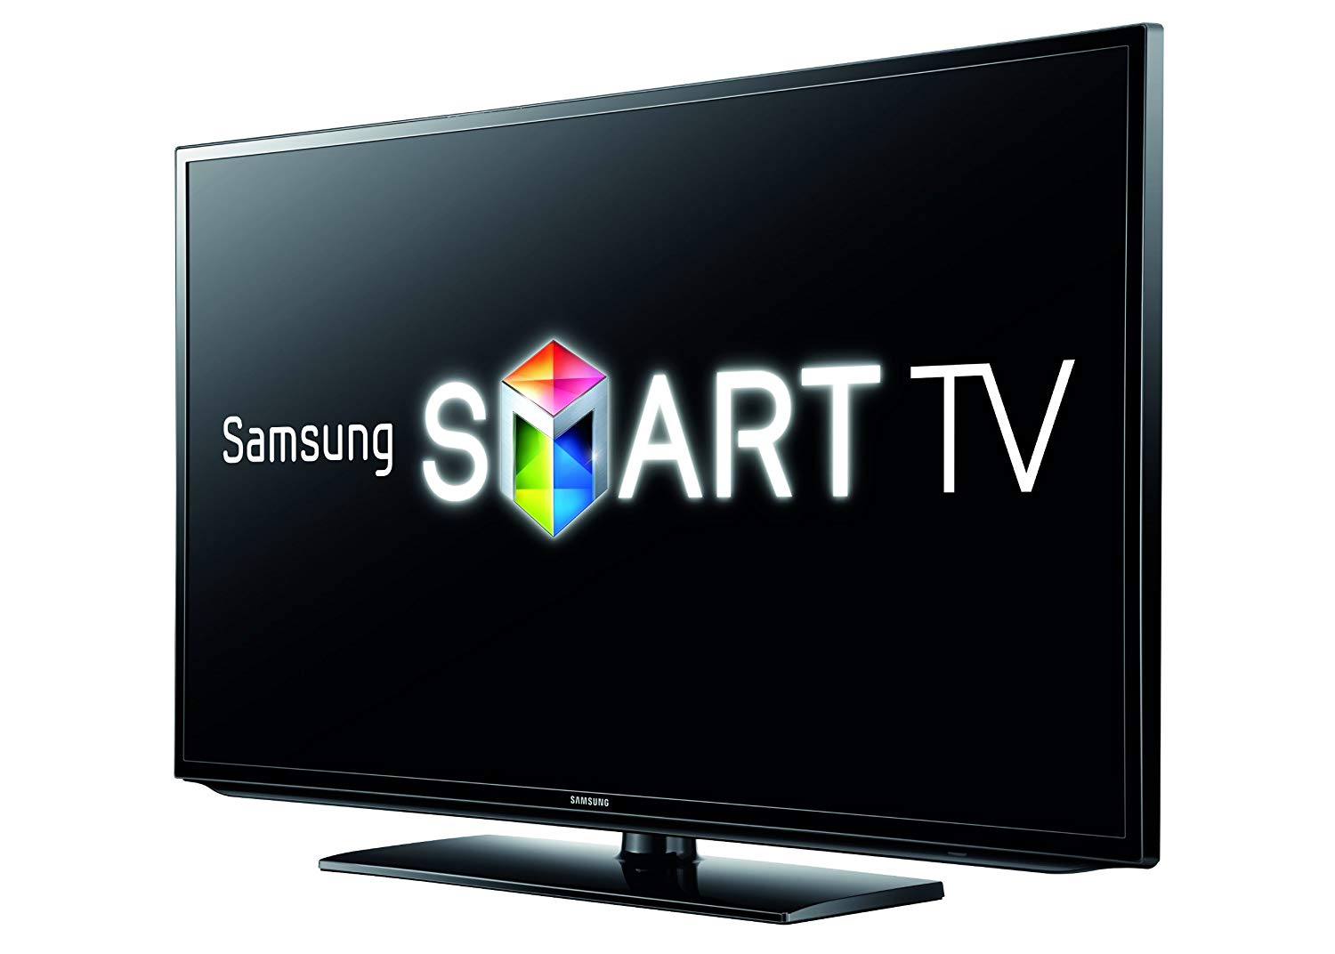
Smart Televisions
Gaming & Entertainment
Samsung Smart TV series
Image courtesy of Amazon https://www.amazon.co.uk/Samsung-UE32EH5300
Notes:
Smart TVs,
Brett Bloethner.

Slide 4
Samsung Smart TVs Overview
Samsung Smart TVs are connected televisions. Cloud services integrated with Samsung's Smart TVs account for much of the value Samsung brings to the extremely competitive television market. Their Smart TV software is designed to bring consumers a seamless entertainment experience from multiple content providers with only one device, an internet connection, and an intuitive interface. The Samsung Smart TV has an SDK available to encourage developers to build apps and further extend the capabilities and value add of Samsung’s Smart TV platform. Many of the biggest names in entertainment already have apps for Samsung Smart TVs
Netflix
Hulu
DirecTV
Spotify
YouTube
https://www.samsung.com/us/explore/smart-tv/highlights/
Notes:
Smart televisions are one of the most influential new innovations to hit the entertainment and gaming industry. Samsung is one of companies leading the way in the highly competitive Smart TV market. Smart TVs are a huge jump in functionality and capability from traditional televisions. They incorporate apps that bring customers new content that used to require a computer and web browser to enjoy. This new technology has leveled the playing field between old school cable service providers and new media such Netflix and Hulu and it’s changed the way many consumers watch television.

Slide 5
Benefits & Advantages Over Traditional Televisions
Samsung Smart TVs are software based and provide a handful of benefits over traditional televisions...
Updateable
Developers can iterate on the UI and features, improving them as the learn more about the user
Developer may be able to release updates to fix certain issues with the device
Apps and downloads
Functionality of the television can be extended at a later date via app downloads
3rd parties pay the cost of app development, adding value to the platform for Samsung
Apps and features can be released as market demands change, keeping the device competitive
Data collection
Viewership data can be collected to aid in improving the experience
Data can also be collected and sold to advertising companies for profit
https://en.wikipedia.org/wiki/Smart_TV
Notes:
From a technical and product development standpoint, Smart TVs have significant benefits over traditional television. This is mainly due to the fact that they’re software and multipurpose processor based IoT devices. This makes Smart TVs updateable which carries a massive benefit over traditional televisions since you can update them to fix bugs, add features, and modify the UI. Because of this capability, designing a television can now be somewhat of an an iterative process, refining the product after collecting and analyzing usage data about the user and their habits, similar to software development.
Apps are another benefit of Smart TVs. They extend the functionality of the Smart TV and enable Smart TV manufacturers and 3rd parties to respond to market demands by changing apps or adding new apps that provide value and features that customers demand, even after having already purchased the device.
One less talked about benefit is data collection. Connected televisions make it much easier to collect and send back viewership and usage data. This leads to some pretty big privacy concerns. Setting that aside, have this data available for developers and content providers makes it easier for them to measure the audience's response to programming and further refine their programming and offerings to target what the market demands and what consumers appear to enjoy.

Slide 6
How Smart TVs are Changing Entertainment
Increasing competition
New age web based media providers are now on the same devices as legacy cable providers
Users can more easily choose between the two, forcing them to be more competitive for business
Improving quality of content
Viewership metrics allow content providers to more easily see what consumers enjoy
More targeted content is created, making consumers happy and bringing in more revenue
Saving consumers money
Enabling “cord cutters” to ditch expensive cable and satellite solutions for cheaper alternatives such as Hulu and Netflix
Forcing innovation from legacy cable and satellite providers
DISH Network’s Sling TV streaming service
DirecTV’s DirecTV Now streaming service
Enabling small time content creators
Smart TV apps like YouTube allow independent content creators to reach billions
Notes:
The introduction of Smart TVs into the marketplace has led to a lot of changes in the entertainment industry. Smart TV apps such as Netflix and Hulu have made it easier for consumers to reach new alternatives to legacy cable and satellite providers, forcing these large companies to innovate and release their own streaming products like DirectTV’s DirecTV Now and DISH Network’s Sling TV. Smart TVs have also enabled cord cutters to more easily ditch cable in return for streaming alternatives and some extra cash saved and web based services like YouTube and Vimeo have made it easier than ever for small independent content creators to reach billions via Smart TV apps.

Slide 7
Challenges
Smart televisions don’t come without their challenges…
Complicated
Consumers who want a simple television experience may look elsewhere
Many apps, configs, and choices could cause anxiety for those used to simply changing channels
Remotes and UIs must be as simple and intuitive as possible for everyone to use the Smart features
Difficult to close the gap between traditional cable and new media
Cord cutters may still demand local stations, which aren’t typically integrated as a Smart feature
Products like AirTV Player are creating a seamless experience with smart tv apps and airwave TV
Privacy concerns
Consumers may avoid smart features out of concern for the privacy of their data
Vizio fined $2M for collecting data on viewer habits without permission
https://www.theverge.com/2017/2/6/14522582/vizio-ftc-lawsuit-tv-viewing-habits-tracking-privacy
Notes:
But Smart TVs aren’t without their challenges. Many Smart TVs are much more complex than their traditional counterparts whose most used functions are channel up, down, volume up, down, and the number pad. So consumers that want the simple TV experience would need to experience an extremely intuitive UI or else they may look for a non Smart TV alternative.
Another challenge is creating a seamless integration or move from traditional tv style content and accessibility to streaming and on demand content. Local stations provide us with a perfect example since many streaming providers cannot provide local stations despite them being free over the airwaves. A few companies have realized this issue and created products, like AirTV, to better bridge the gap between television stations and streaming services for a seamless tv entertainment experience.
Privacy is also a concern since connected TVs have great capabilities to collect and relay viewership data back to content providers. As with any other connected device, it’s important that manufacturers make their customers aware of what data is being collected about them and allow them to opt out. If they don’t they could face fines or even worse lose the trust of consumers and ultimately lose customers.

Slide 8
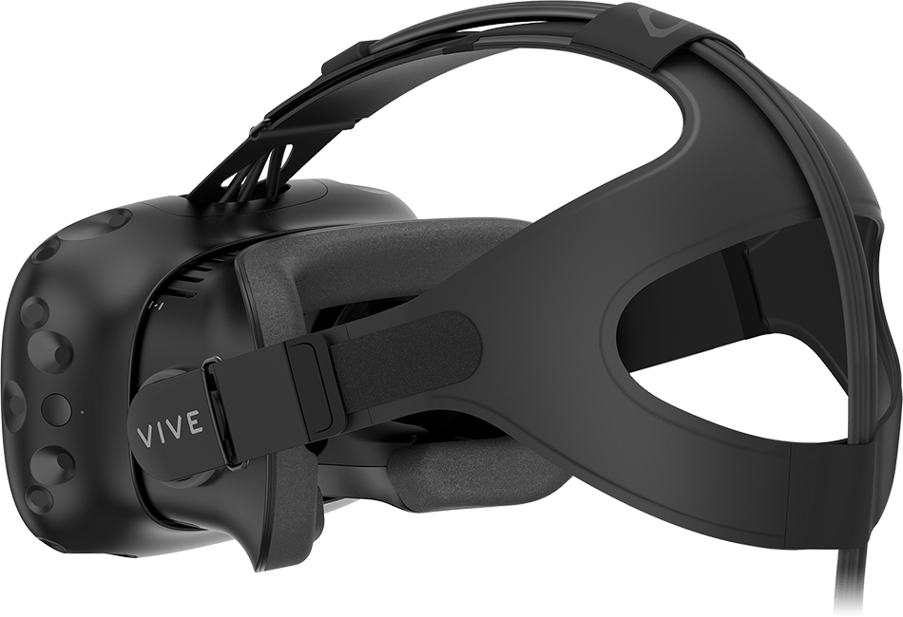
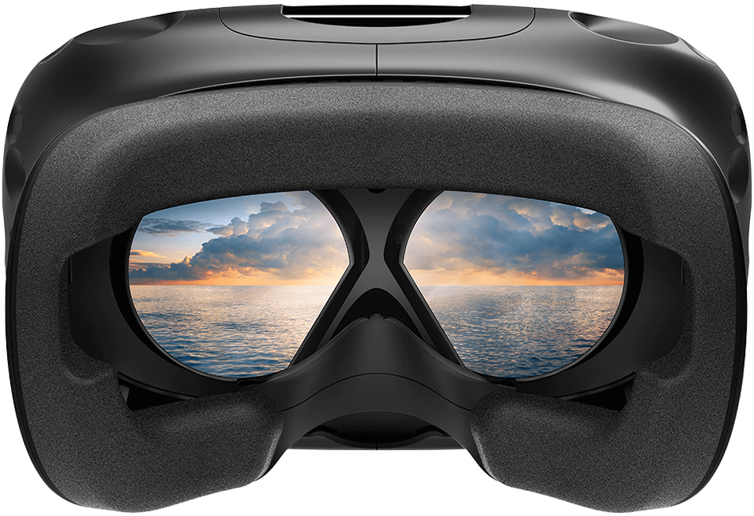
Virtual Reality (VR) Gaming & Entertainment
HTC VIVE
James Byars
Images courtesy of HTC VIVE https://www.vive.com/us/product/vive-virtual-reality-system/
Notes:
VR
James Byars

Slide 9
Overview
HTC VIVE is a wearable Virtual Reality (VR) device. VIVE has been used in a variety of applications such as gaming, interactive media, and the enterprise. VIVE provides developers with a Software Development Kit (SDK) in order to create custom VR experiences. The VIVE ecosystem has a dedicated game store built on top of Steam^{[1]} where developers can release games and experiences for consumers.
There are 3 main components of the VIVE system:
Headset
Hand-held controllers
Room sensors
[1] https://store.steampowered.com/

Slide 10
How HTC VIVE Is Changing Entertainment & Gaming
HTC VIVE and VR are fundamentally changing the Entertainment and Gaming industries.
VIVE brings users into games and entertainment, allowing them to immerse themselves into the experience.
Entertainment producers and Game development must change from guiding consumers along a ‘path’ to free roaming and handling a nearly infinite number of possible actions.
Entertainment experiences can now be brought to consumers rather than needing to physically attend an event.

Slide 11
Challenges In Entertainment & Gaming
Starting at $599 USD for the base model plus a $1000+ PC, the HTC VIVE and other VR kits have a high barrier to entry.
Developers and producers must change the way games and entertainment experiences are developed to deliver a truly immersive experience.
Consumers risk physical injury from falling down and/or bumping into other objects in the room. How will risk of physical injury be mitigated?
Entertainment studios and game developers must consider the impact of possibly traumatic events experienced by consumers. How real is real enough?

Slide 12
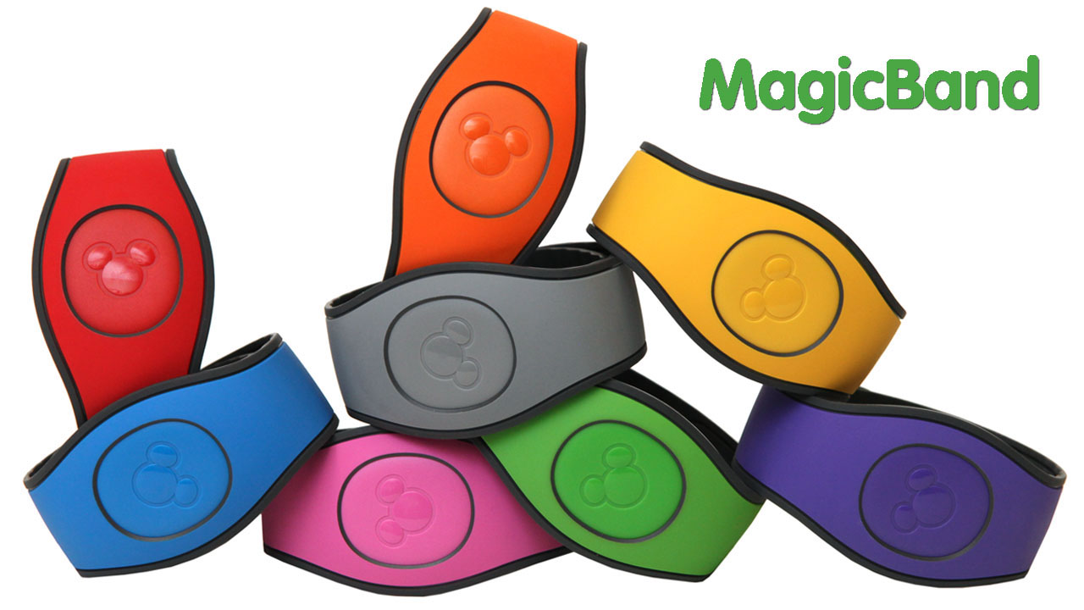
RFID Wristbands
Theme Parks
Image courtesy of Disney Parks: https://disneyparks.disney.go.com/blog/2016/11/magicband-2-coming-to-walt-disney-world-resort/
Disney’s MagicBand

Slide 13
Overview
MagicBands are silicon wrapped bracelets that use RFID technology.
Guests’ room reservations and park tickets are stored on the band, and they use the band to enter the theme parks as well as their hotel room. Guests can log on to the My Disney Experience app prior to their vacation to preselect dining and fastpass reservations, which are also stored on the band. Guests may also choose to store credit card info on the band and use it to make purchases across the resort.
Inside the bracelet, there are two antennas, one for short-range signals and one for long-range signals. The short range antenna is used for guest actions like park entry or room entry, while the long antenna allows Disney to gather data such as where the guest is located.
https://gizmodo.com/how-i-let-disney-track-my-every-move-1792875386

Slide 14
How MagicBands are Changing Entertainment & Gaming
MagicBands allow guests to travel lighter, as most everything they need will be stored in the band.
The bands help Disney create more personalized experiences for their guests. For example, Disney can use the band to automatically upload photos taken of guests on rides to their “My Disney Experience” account. Cast members can also now see guests’ names as they pass through certain areas, and greet them.
The bands can also help with crowd and quality control. Disney uses the bands to examine guest behavior patterns and can use that information to quickly devote more resources to busy areas.
https://disneyworld.disney.go.com/ faq/bands-cards/how-to-use-magic-band/

Slide 15
Challenges In Entertainment & Gaming
The main challenge the MagicBand could face in increasing its use would be privacy. While the bands are very convenient, they are also a little invasive. Many people may not be comfortable with Disney knowing their every move while they are on vacation. And, even though using the band as a payment method requires a PIN, many people may also be wary of putting their credit card information on it. As of right now, guests can still opt to use a traditional room key and park ticket if they wish.

Slide 16
Questions?

